Slide 1
BLOG!

Slide 2
What is it?
https://blog-hackathon.herokuapp.com
IT’S A BLOG!

Slide 3

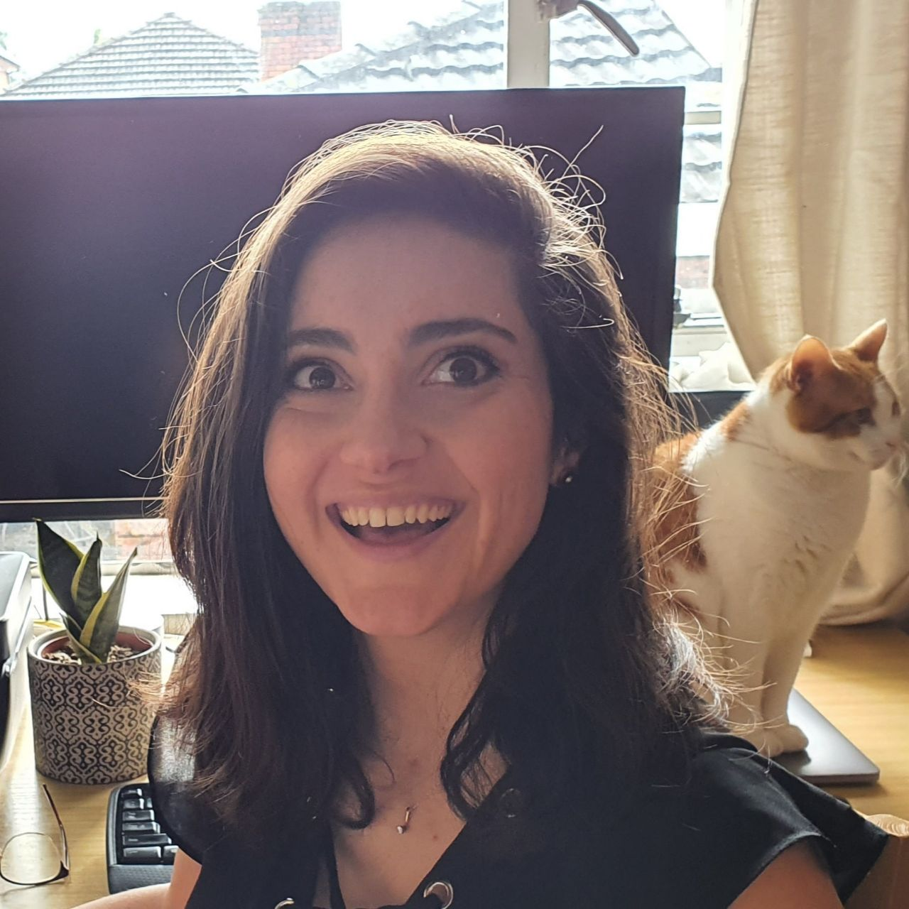
Us!

Slide 4
What problem? We had to make something for Hackathon and we didn’t completely understand the classwork and wanted to practice

Slide 5
Wireframes and planning…

Slide 6
Screenshots of live site

Slide 7


Tests

Slide 8
MVC

Slide 9
Passport Authentication

Slide 10
Trello

Slide 11


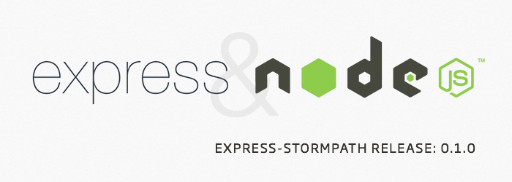




Tech Stack

Slide 12
Difficulties
Displaying info on different routes e.g. posts on home route.
EXPORT YOUR FUNCTIONS
Designing is hard.
Grid with images.

Slide 13
What we learned…
Git workflow!
Pairing can be ok!
- All of the code things

Slide 14
Future Improvements
Add Update/Delete functions to views.
Fully responsive.
More accessible.
Image uploads to posts and user profiles.
Search function.
Automated testing.
User stories
So many things we didn’t have time for.

